Slide 1
Material for this workshop
This presentation
ArchR_demo_1_create_arrow_files.Rmd
ArchR_demo_2_analysis.Rmd
Input data
Please follow the pre-workshop instructions on the workshop webpage

Slide 2
Introduction to scATAC-seq Data Analysis
April 17-18 2025
Reuben Thomas
Michela Traglia
Ayushi Agrawal

Slide 3
Introductions
Reuben Thomas
Associate Core Director
Michela Traglia
Senior Statistician
Ayushi Agrawal
Bioinformatician III
Natalie Elphick
Bioinformatician I
Notes:
https://www.pnas.org/doi/10.1073/pnas.2206450119

Slide 4
Aim of the workshop
To give an overview of the biological insights using scATAC-seq analysis
Highlight assumptions and limitations underlying the methods
Understand the relevance and impact of difference between scRNAseq and scATAC-seq workflow
Experience how to analyze scATAC-seq data in ArchR
Notes:
https://www.pnas.org/doi/10.1073/pnas.2206450119

Slide 5
Workshop organization
Session 1 (Thursday, 9am-12pm)
Cell regulome and ATAC-seq
Technology
From sequencer to fragments file
Pre-processing and QC
Break
Normalization, Dimensionality reduction, embedding
Clustering and cell type annotation based on feature markers
Break
Advance analysis: Calling Peaks and Motif enrichment
Session 2 (Friday, 9am-12pm)
Intro to ArchR
Demo
scATAC-seq and scRNA-seq Data Integration workshop - April 24 at 1pm
Register here
Notes:
https://www.pnas.org/doi/10.1073/pnas.2206450119

Slide 6
Chromatin architecture of the regulatory regions
Notes:
https://www.pnas.org/doi/10.1073/pnas.2206450119

Slide 7
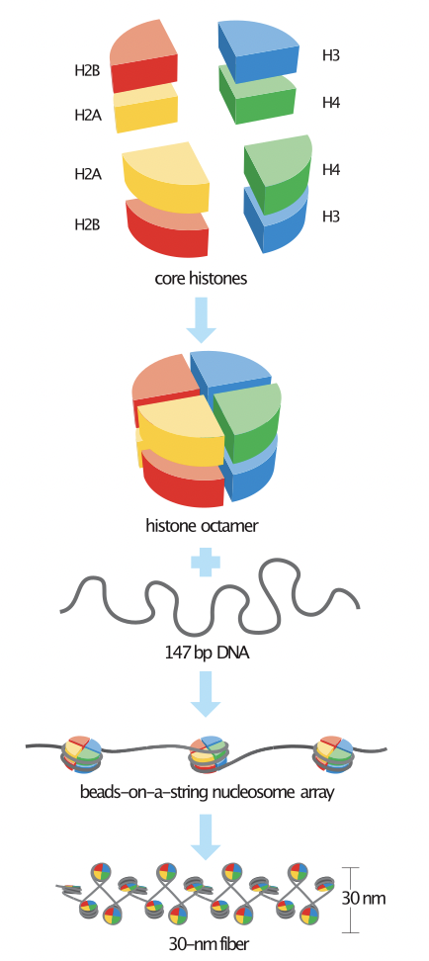
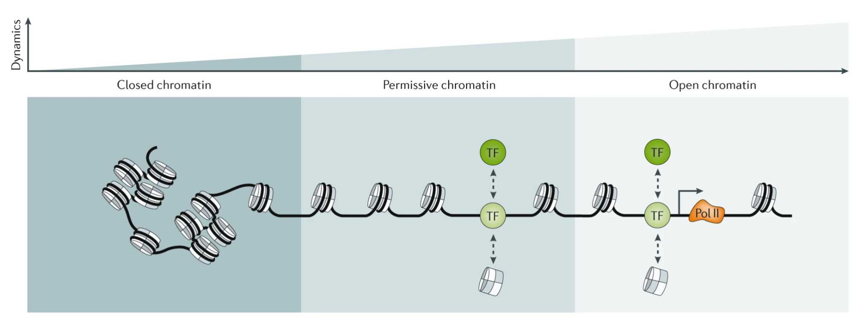
Chromatin accessibility
Klemm et al, Nature Reviews Genetics
Nucleosome is an octamer of histone proteins wrapped by ~147 bp of DNA.
Organized into chromatin with limited accessibility to external factors.
Accessibility is dynamic and depends by the occupancy and topological organization of nucleosomes.
Notes:
https://www.nature.com/articles/s41576-018-0089-8

Slide 8
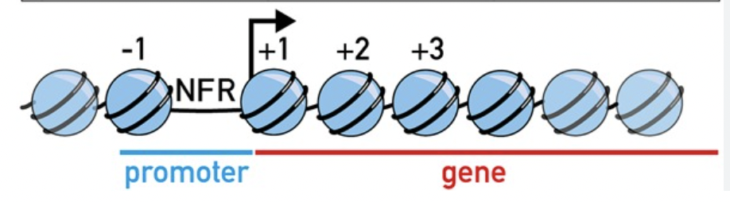
Non uniform organization of nucleosomes
Nucleosome depletion at regulatory loci (promoters, enhancers, etc.)
Nucleosome-free regions (NFRs) are localized just upstream of the transcription start site (TSS).
First nucleosome downstream of the TSS (the + 1 nucleosome) is strongly localized at the same location across cells.
Accessible genome comprises ~2–3% of total DNA sequence
> 90% of regions bound by Transcription Factors (TF).
Genome-wide profiling of chromatin accessibility to identify candidate regulatory genomic regions in a tissue or cell type
Notes:
https://www.sciencedirect.com/science/article/pii/S0012160609009245#bib50
Activities of all cis-regulatory elements (CREs) in its genome.
Understanding how genes’ transcriptional activities are regulated in normal and pathological conditions.
Conventionally, studied with bulk technologies:
Chromatin immunoprecipitation coupled with sequencing (ChIP-seq)
DNase I hypersensitive site sequencing (DNase-seq)
Assay for transposase-accessible chromatin followed by sequencing (ATAC-seq).
Cells’ average behavior in a biological sample consisting of thousands to millions of cells.

Slide 9
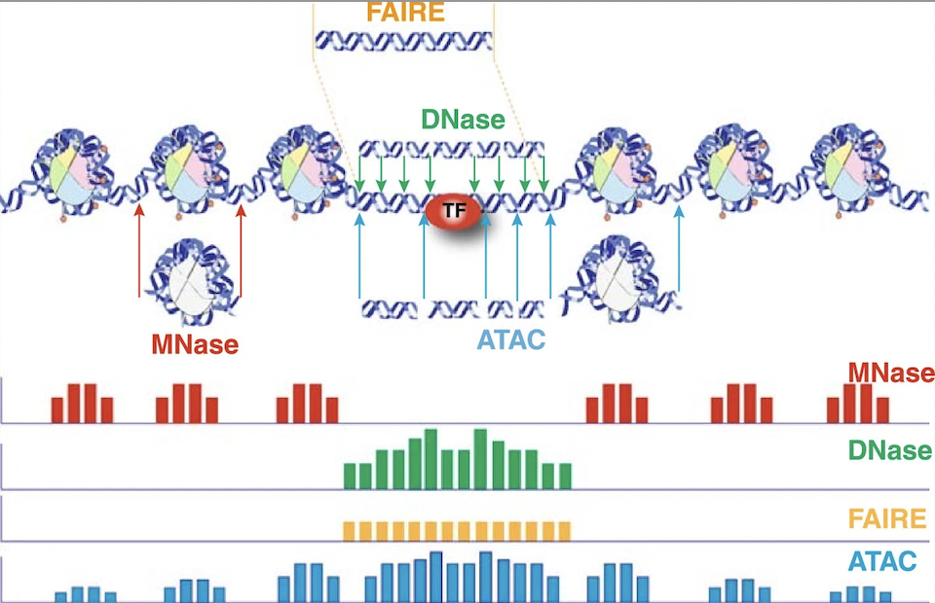
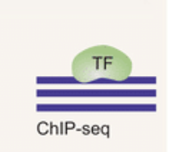
Which regulatory region are you interested in?
MNase: indirect study of accessibility - nucleosome occupancy
DNase: DNase I hypersensitive site - nucleosome depleted regions
FAIRE: easy but background
ATAC:
simple and fast two-step protocol
high sensitivity
low starting cell number (500 to 50,000 cells)
multiple aspects of chromatin architecture simultaneously at high resolution.
ChIP-seq : binding sites of DNA-associated proteins and can be used to map global binding sites for a given protein.
Notes:
https://www.ncbi.nlm.nih.gov/pmc/articles/PMC4253006/

Slide 10
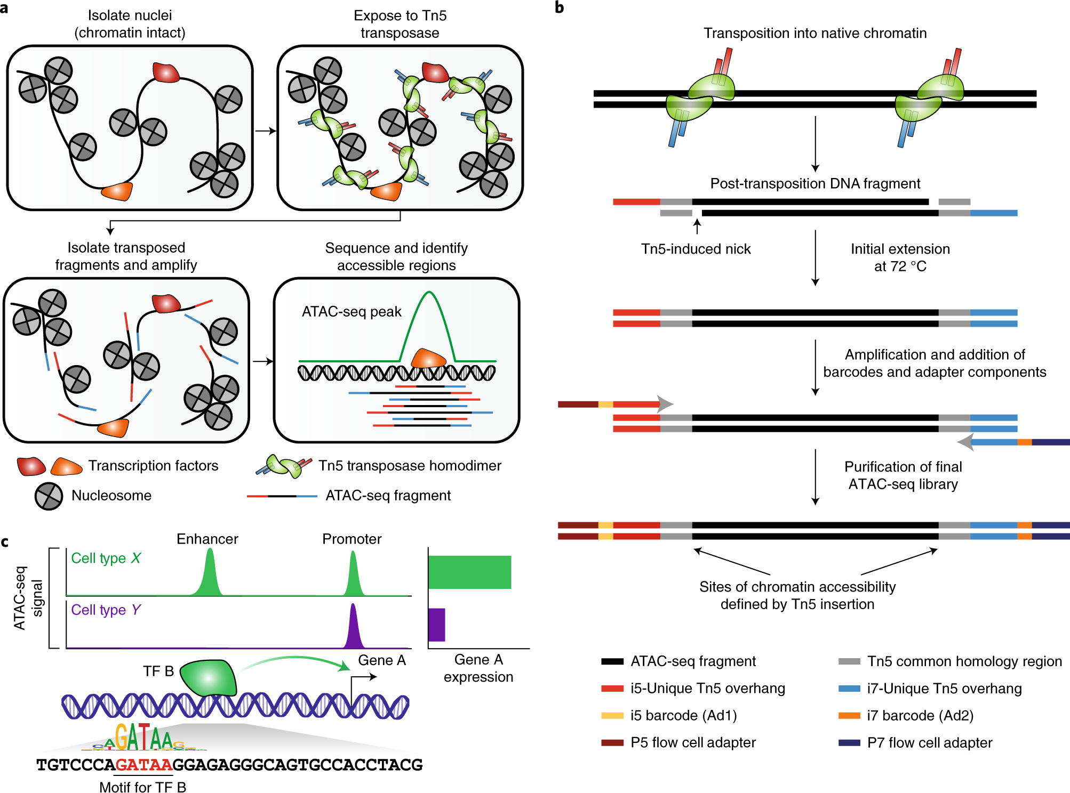
ATAC is based on the transposition system
Assay for Transposase-Accessible Chromatin with high-throughput sequencing
Transposons are genetic elements that can “jump” to different locations within a genome.
Bacterial Tn5 - encode a hyperactive Tn5 transposase (Tnp) that can simultaneously cut accessible DNA fragments and ligate sequencing adapters to both strands.
Fast “cut and paste” and “copy and paste” functions.

Slide 11
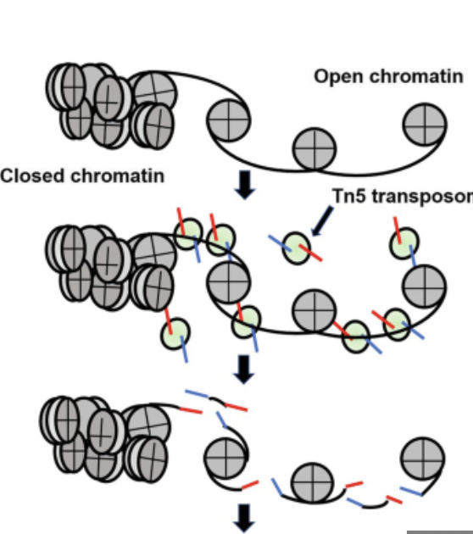
Transposition events create fragments
The central point of the “accessible” site is in the very center of the Tn5 dimer, not the location of each Tn5 insertion.
Adjusting plus-stranded insertion events by +4 bp and minus-stranded insertion events by -5 bp.
Paired-end sequencing.
Binds as a homodimer with 9-bp of DNA between the two Tn5 molecules.
Two transposition events = FRAGMENT
Notes:
https://www.nature.com/articles/s41596-022-00692-9

Slide 12
Tn5 application
2D structure:
Bulk ATAC-seq
scATAC-seq to study the dynamically regulated chromatin in a cell type-specific manner
Spatial proximity within the nucleus by analysing contacts between genomic regions:
High-throughput sequencing for the study of chromatin 3D structure - chromatin conformation capture assays 3C (one vs one) and Hi-C (all vs all).

Slide 13
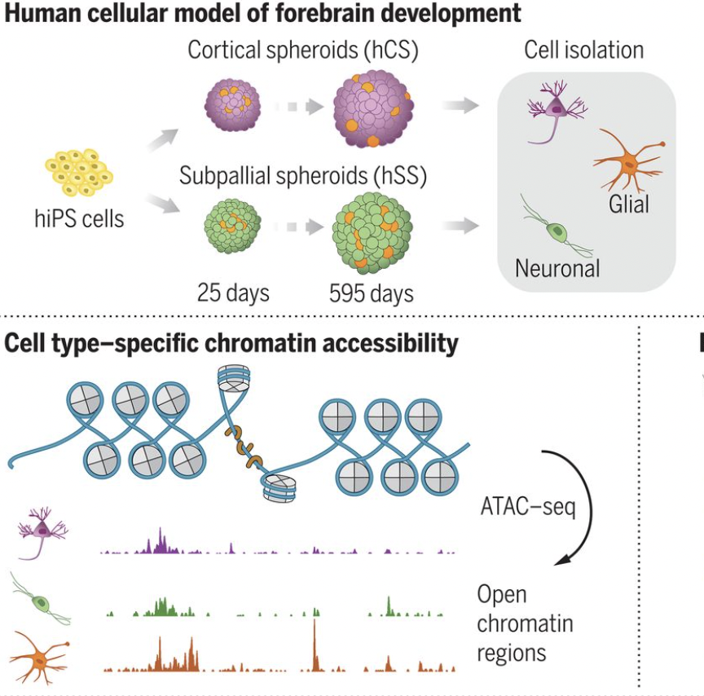
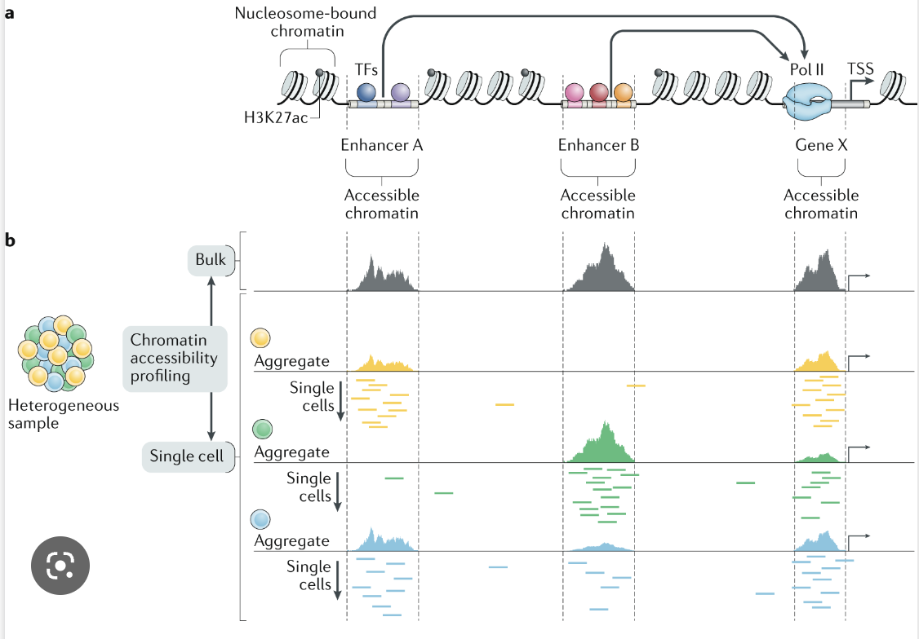
Experimental design is fundamental (I)
Which epigenetic mechanism do you need to study?
Is single cell suitable for my purpose?
Nature Reviews Methods Primers, 2021
vol 2021
Trevino et al, Science 2020
Notes:
https://www.10xgenomics.com/blog/is-single-cell-epigenomics-right-for-me-atac-ing-your-research-questions-for-deeper-insights
https://www.10xgenomics.com/products/single-cell-multiome-atac-plus-gene-expression

Slide 14
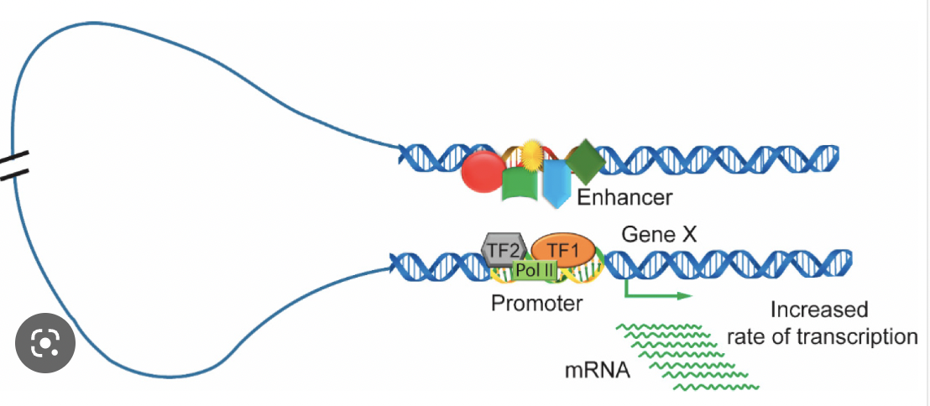
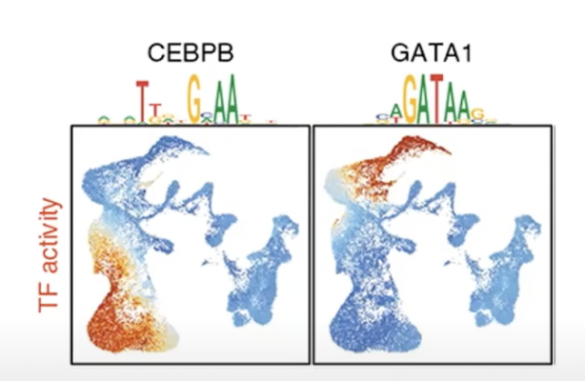
What biological insight we can get from scATAC-seq
One step further than scRNA-seq:
In trajectory analysis, identify variable TF and enhancers
Gene regulatory networks between transcription factor gene and accessible target genes
Notes:
https://www.nature.com/articles/s41596-022-00692-9
https://www.mdpi.com/2073-4409/8/10/1281

Slide 15
scATAC-seq workflow
From bench
Through the bioinformatic analysis
To the biological interpretation
Your cell’s regulome question
Fragments count
Embedding
Library preparation & sequencing
QC filtering low quality cells
Clustering
Demultiplex, read alignment and quantification
Layered dimensionality reduction
Find Markers - cell annotation
For more biological insight in cell’s regulome
Peak calling
Motif Enrichment
Motif Footprinting
Notes:
https://www.pnas.org/doi/10.1073/pnas.2206450119

Slide 16
2. scATACseq technology
Notes:
https://www.pnas.org/doi/10.1073/pnas.2206450119

Slide 17
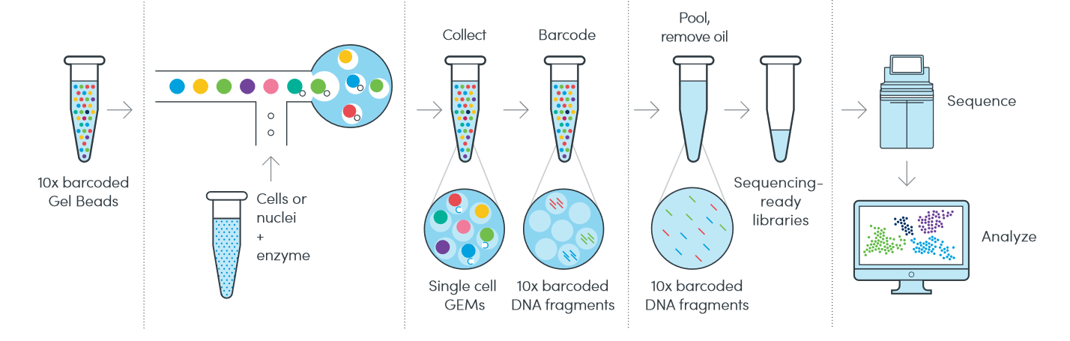
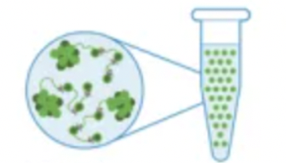
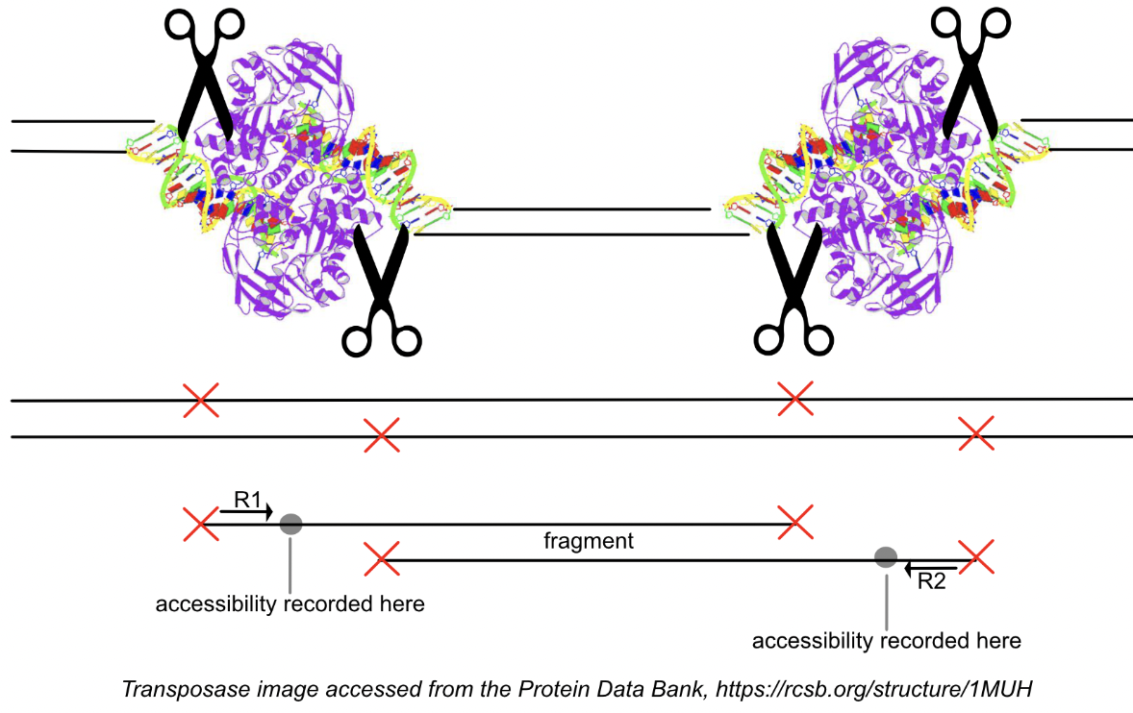

Single cell ATAC-seq protocol
Transposition of nuclei
10X Genomics scATAC-seq website
doublets
Tn5 enters the nuclei, fragments DNA in open chromatin regions, and adds the indexing adapters
Notes:
https://www.youtube.com/watch?v=BFXwJytgVI4
https://www.activemotif.com/blog-single-cell-atac-seq

Slide 18
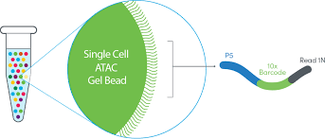
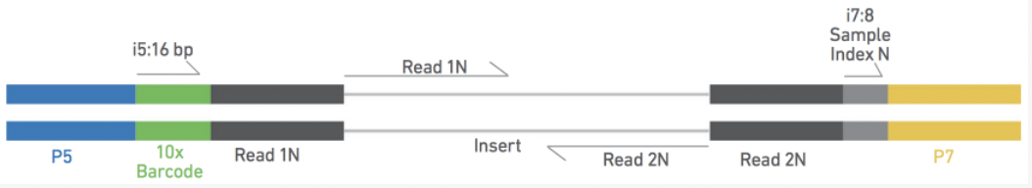
Single cell ATAC-seq protocol
Identify nucleus of origin
Identify sample of origin (i.e. pooling)
10X Genomics scATAC-seq website
Notes:
https://www.youtube.com/watch?v=BFXwJytgVI4

Slide 19
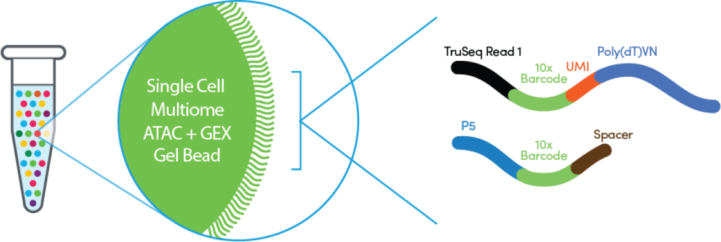
Experimental design is fundamental (II)
Do I need to perform scRNA-seq and scATAC-seq separately or Multiome analysis (scATAC+scRNAseq)?
Multiome:
Simultaneously profiling gene expression and open chromatin from the same cell.
More straightforward downstream analysis.
No need to integrate scRNA and scATAC seq data.
Costs
Notes:
https://www.10xgenomics.com/blog/is-single-cell-epigenomics-right-for-me-atac-ing-your-research-questions-for-deeper-insights
https://www.10xgenomics.com/products/single-cell-multiome-atac-plus-gene-expression

Slide 20
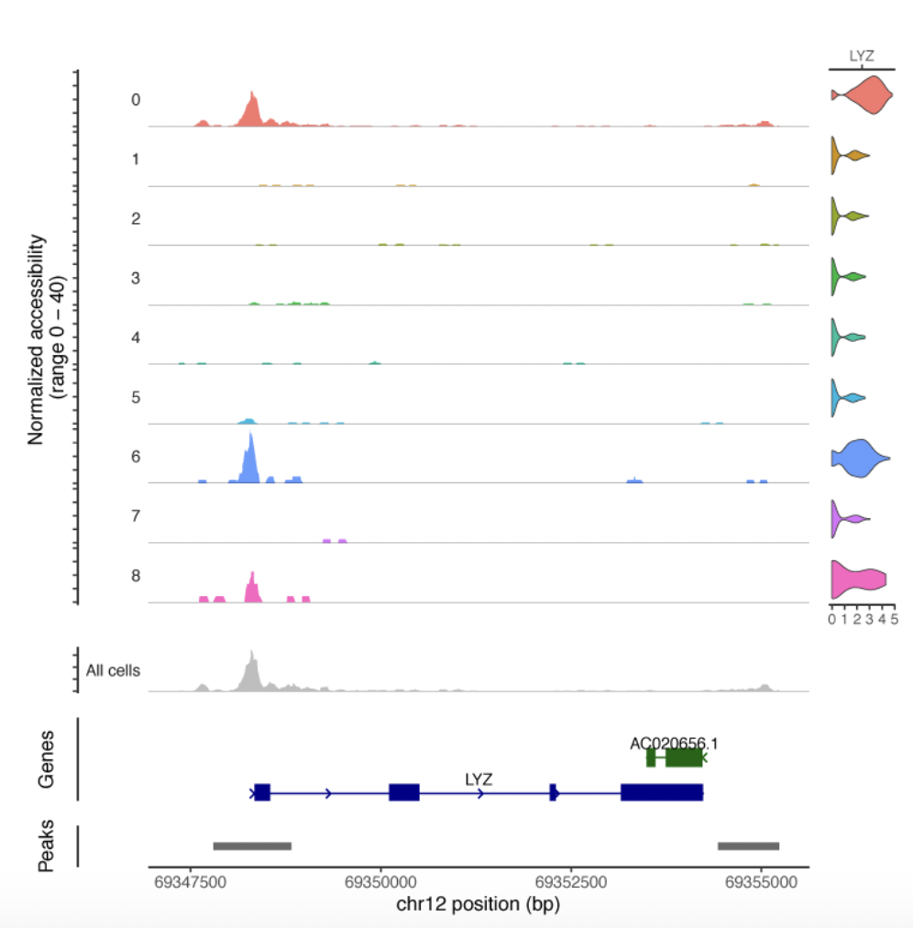
Simultaneously expression and accessibility profiles
Clusters of gene expression for LYZ
Recommendation: whether the budget allows, use Multiome
Data provided by 10X Genomics.
Notes:
https://www.activemotif.com/catalog/1355/single-cell-multiome-service

Slide 21
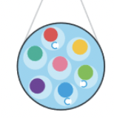
Caveats of scATAC-seq
A typical human scATAC-seq dataset contains 100 - 10,000 cells and 1,000 - 100,000 sequence reads per cell.
Drops with no cell/doublets
Low detection efficiency - limited # of accessible regions from each cell (5–15% of peaks detected)
In a cell, most cis-REs don’t have mapped read - cis-REs in the genome >> 100,000.
Activities of all cis-regulatory elements is a continuous steady-state activity in a cell.
-> scATAC-seq give a picture of a specific timepoint.
Notes:
https://www.pnas.org/doi/10.1073/pnas.2206450119
https://www.nature.com/articles/s41467-021-21583-9

Slide 22
Knowledge check 1
Using scATAC-seq, it is possible to identify:
An enhancer active in different cell types.
A gene poorly expressed in a particular cell type.
Cell-specific peaks of accessible chromatin
All of the above.
Notes:
https://www.pnas.org/doi/10.1073/pnas.2206450119

Slide 23
3. From raw sequencing data to the fragments file
Tool: Cellranger-ATAC
Notes:
https://www.pnas.org/doi/10.1073/pnas.2206450119

Slide 24
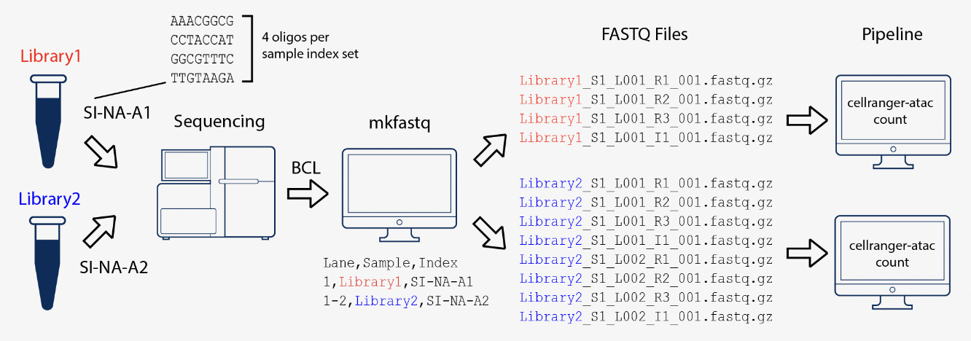
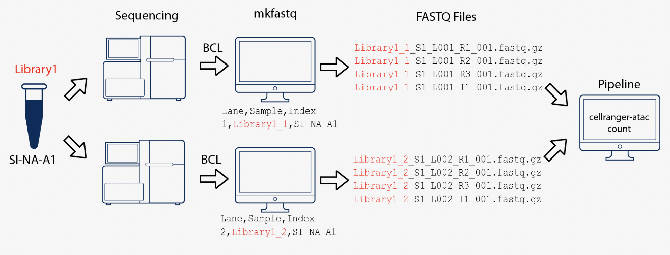
Cellranger ATAC
Two 10x Genomics libraries - multiplexed on a single flow cell
Demultiplex (BCL to FASTQ)
cellranger-atac mkfastq
Alignment, filtering, barcode counting, and additional steps
cellranger-atac count
Aggregate counts from multiple runs
cellranger-atac aggr
One 10x Genomics library sequenced on two flow cells
Reads mapped to chrM, specified as non-nuclear contigs, are filtered out
(Images from 10x Genomics website)
Notes:
https://www.pnas.org/doi/10.1073/pnas.2206450119

Slide 25
Cell Ranger-ATAC outputs
BAM files with aligned reads
web_summary.html
Fragments and bulk peak files.
Secondary analysis (e.g., dimensionality reduction, clustering, etc.) -> discard
Loupe file to interactively view secondary analysis results with Loupe Browser from 10x Genomics
Molecule info

Slide 26
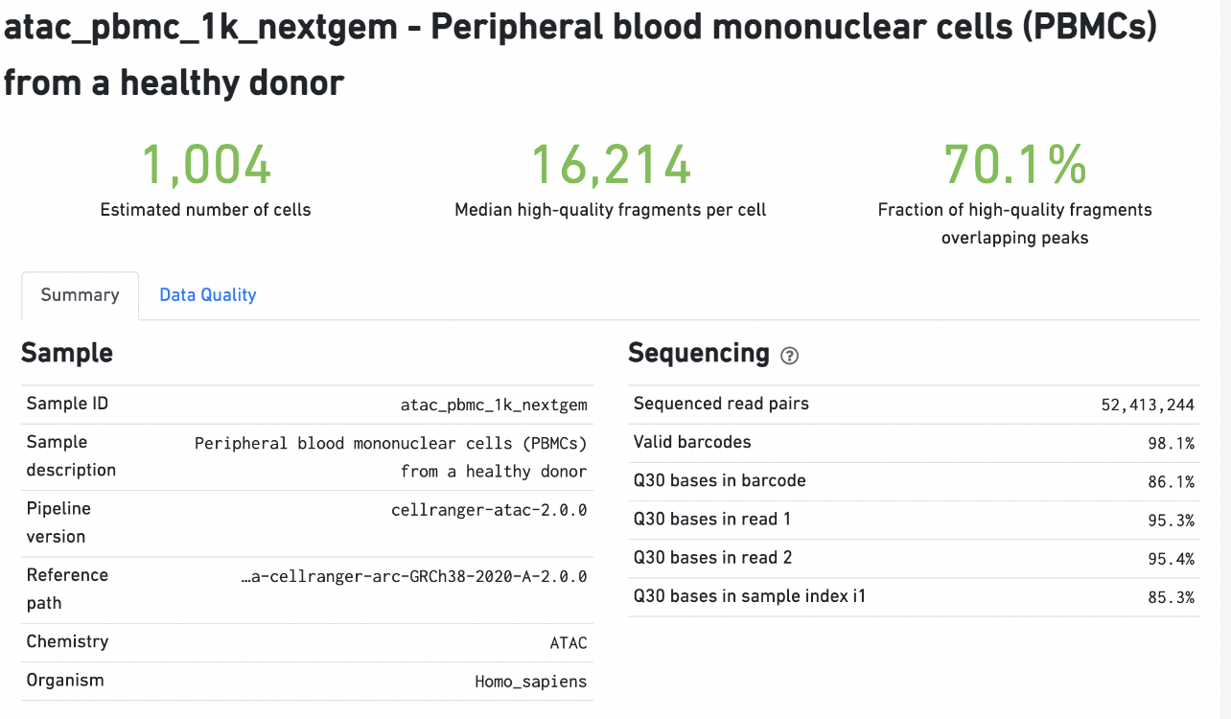
Cell Ranger outputs (more detail on HTML output)
Notes:
https://support.10xgenomics.com/single-cell-atac/software/pipelines/latest/output/summary

Slide 27
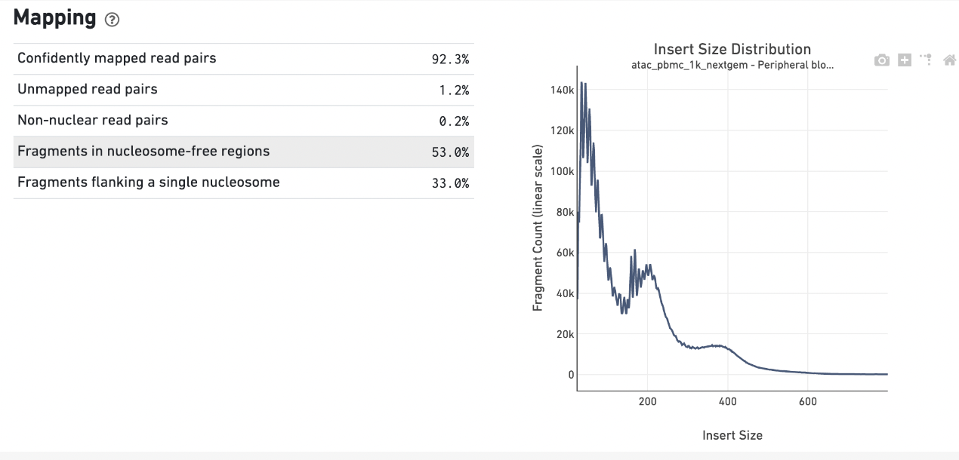
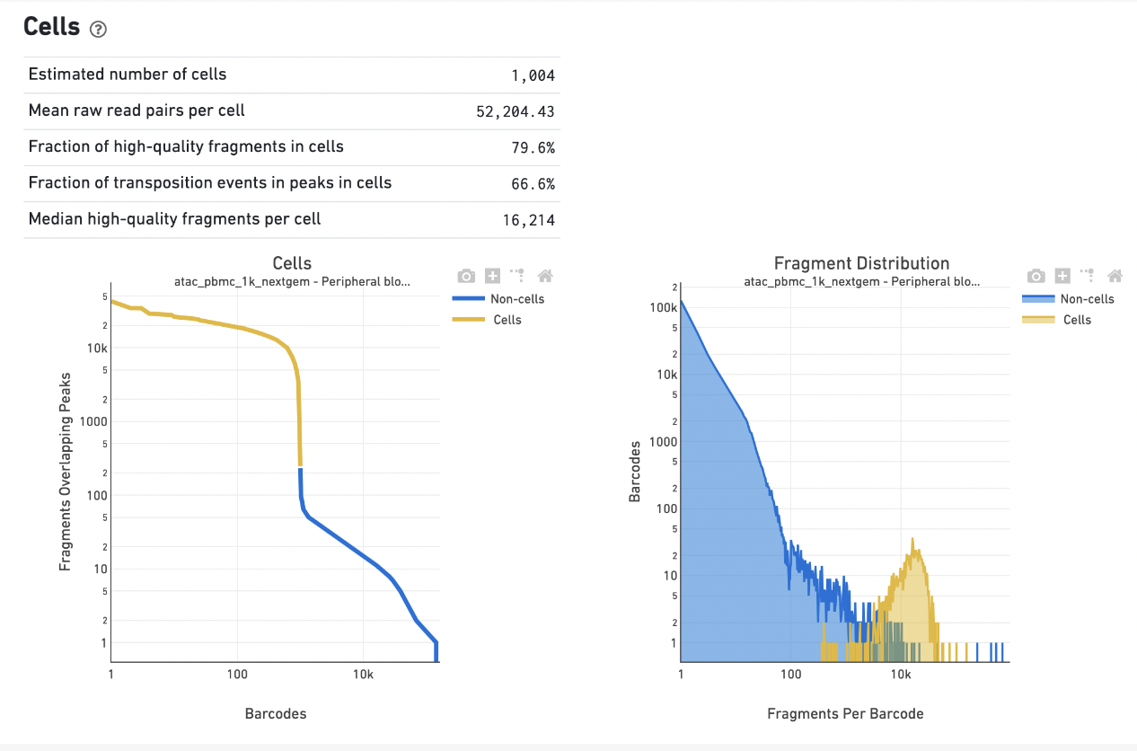
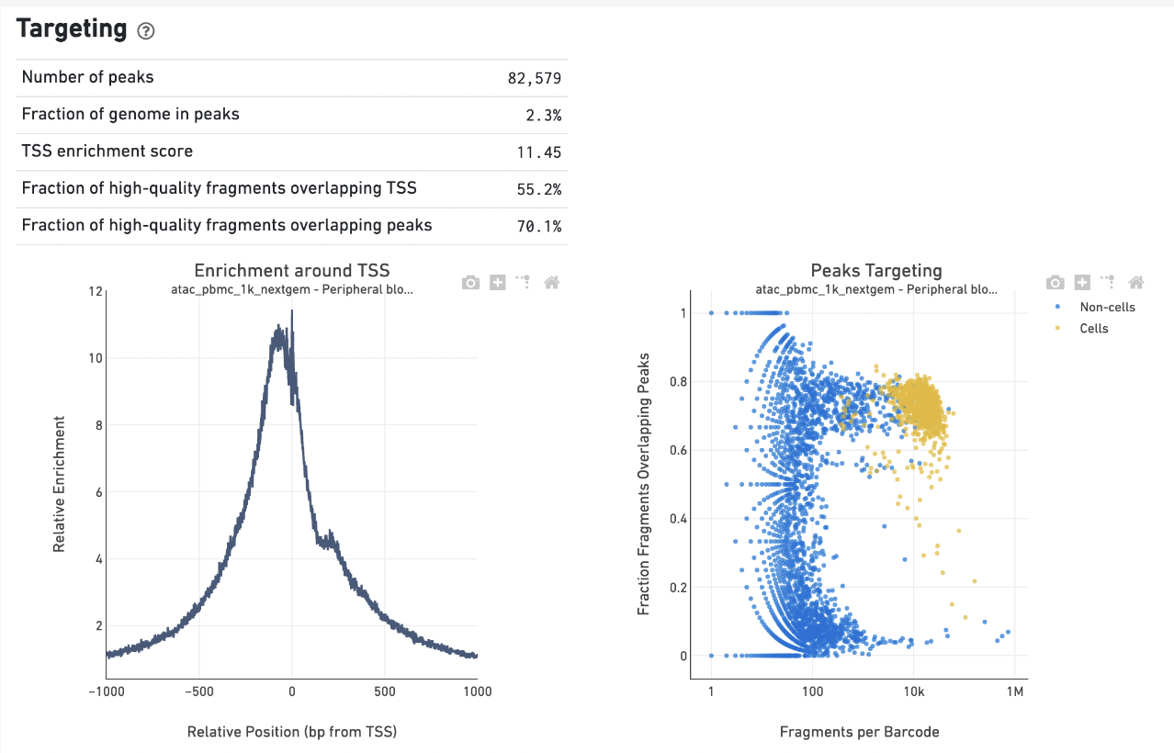
Cell Ranger outputs (more detail on HTML output)
Notes:
https://cdn.10xgenomics.com/image/upload/v1660261285/support-documents/CG000202_TechnicalNote_InterpretingCellRangerATACWebSummaryFiles_RevB.pdf

Slide 28
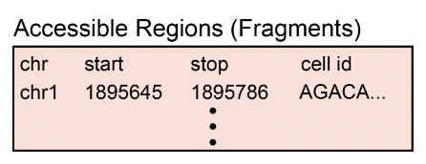
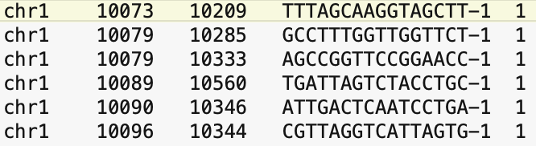
Output cellranger -> fragments linked to the cell ID
atac_fragments.tsv.gz
Header lines: # record information about the sample, the reference used and primary contigs in the reference.
Each scATAC-seq fragment and the corresponding cell ID, one fragment per line.
Notes:
https://www.pnas.org/doi/10.1073/pnas.2206450119
The pipeline outs/ folder contains fragments.tsv.gz and fragments.tsv.gz.tbi. The fragments.tsv.gz contains one line per unique fragment, with tab-separated fields as described below. Additionally, header lines beginning with # record information about the sample, the reference used and primary contigs in the reference. The data is block-gzipped to allow indexing and to save disk space. The fragments.tsv.gz.tbi file is a tabix index of the fragment intervals facilitating random access to records from an arbitrary genomic interval. The tabix index is created with --preset=bed. Positions in the fragments.tsv.gz file, as in a BED file, are 0-based.

Slide 29
Different frameworks to process the fragments and perform the analyses downstream.
SnapATAC - Nature Comm 2021 and SnapATAC2 - Nature Methods 2024
Signac - extension of Seurat for the analysis of single-cell chromatin data
ArchR - shown during this workshop [paper]
Notes:
majority of accesible regions are not transposed and this leads to many loci having 0 accessibile alleles
binarized scATAC-seq data matrix. This binarized matrix still ends up being mostly 0s because transposition is rare

Slide 30
4. Pre-processing and cell QC
ArchR: ArchRProject(); createArrowFiles()(
addDoubletScores();filterDoublets()
plotGroups(); plotFragmentSizes()

Slide 31
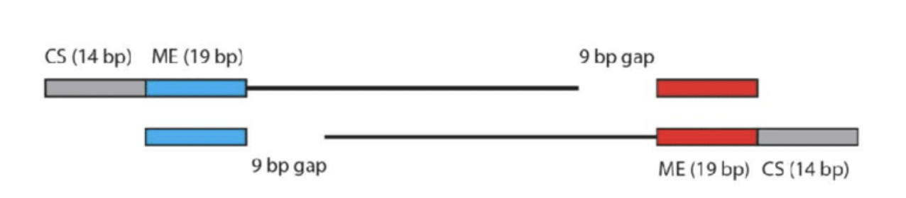
Fragments position need to be adjusted for 9bp -> insertions
In ArchR for rapid access, fragment files chunked and converted to a compressed temporary HDF5-formatted file including:
Chromosome
offset-adjusted chromosome start position
offset-adjusted chromosome end position
Cellular barcode ID.
insertions-> the offset-adjusted single-base position at the very center of an accessible site.

Slide 32
Sparsity of data issue
Transposition is rare.
Majority of accessible regions are not transposed -> many loci having 0 accessible alleles.
1= accessible; 0=???
0 in scATAC-seq could mean “not-accessible” or “not sampled”
Binarized scATAC-seq data matrix mostly 0s.

Slide 33
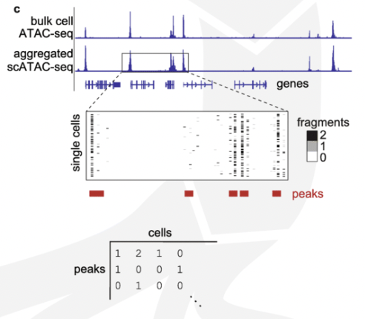
Input for analyses downstream
Count matrix on a set of peaks (Signac - Stuart lab)
Bulking cells to call peak -> no rare cells peaks
Genome-wide tiles (SnapATAC, SnapATAC2 and ArchR)
5kb - SnapATAC
Accessibility regions are long bp << 5kb
ArchR + SnapATAC2 implement insertion counts across genome-wide 500bp tiles
Better resolution
Allows for the identification of clusters prior to calling peaks
3B bp in 500bp tiles: 6 million features to be included in the cell by tile matrix
createArrowFiles(..,addTileMat = TRUE)

Slide 34
Knowledge check 2
What is the best input matrix for sparse data to preserve cell specificity:
Bulk peak matrix (across cells)
Insertion counts across genome-wide tiles
Notes:
https://www.pnas.org/doi/10.1073/pnas.2206450119

Slide 35
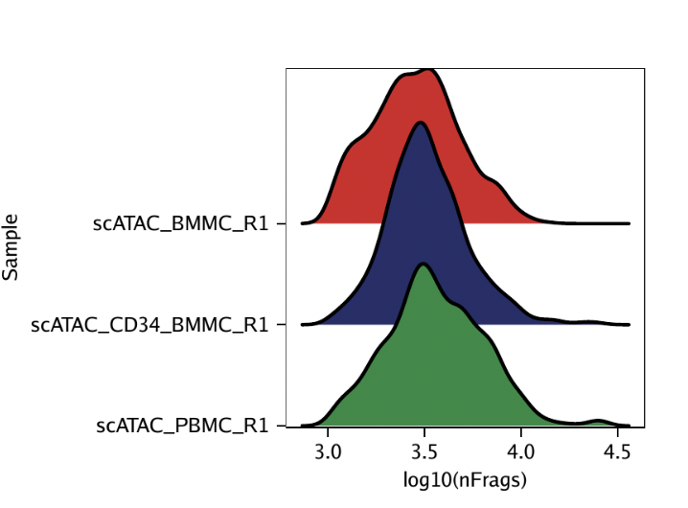
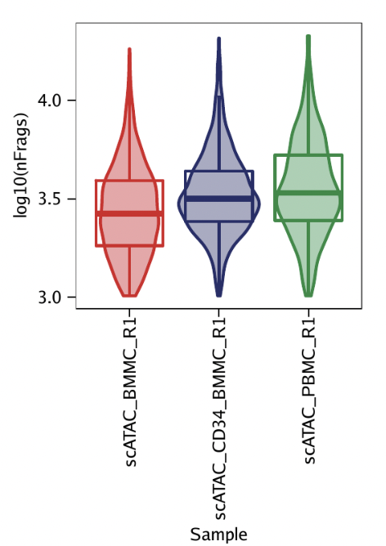
Filtering out low quality cells
Number of unique nuclear fragments > 1000
plotGroups(..., name = "log10(nFrags)",..)
plotGroups(..., name = "log10(nFrags)",plotAs = "violin")

Slide 36
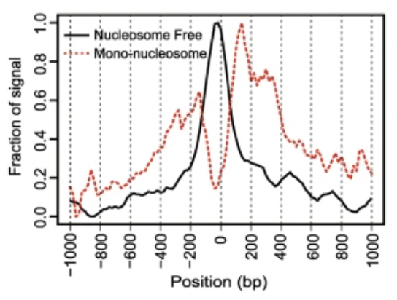
Filtering out low quality cells
2. Signal-to-background ratio - > TSS enrichment
Nucleosome-free regions (NFR) (< 100 bp)
Mono-, di-, and tri-nucleosomes regions (~ 200, 400, 600 bp, respectively)
Fragments from the NFR enriched around the transcription start site (TSS) of genes.
Fragments from nucleosome-bound regions depleted at TSS + enrichment of flanking regions around TSS.
Notes:
https://genomebiology.biomedcentral.com/articles/10.1186/s13059-020-1929-3

Slide 37
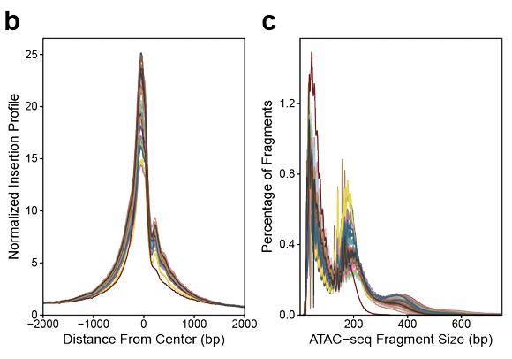
Filtering out low quality cells
2. Signal-to-background ratio - > TSS enrichment
NFR enriched at gene TSS regions compared to other genomic regions.
Aggregated distribution of reads centered on the TSSs - avg accessibility
Extension of 2000 bp in either direction.
Normalized by the average read depth in the 100 bps at each of the end flanks.
Fold change at each position over that average read depth.
Increase in signal up to a peak in the middle.
TSS enrichment metric is the signal value at the center of the distribution after this normalization.
plotTSSEnrichment()
Good quality cells TSS > 4
Low signal-to-background ratio -> dead or dying cells (de-chromatinized DNA allows for random transposition genome-wide).

Slide 38
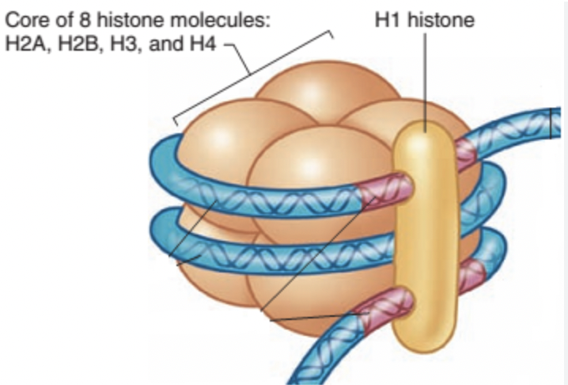
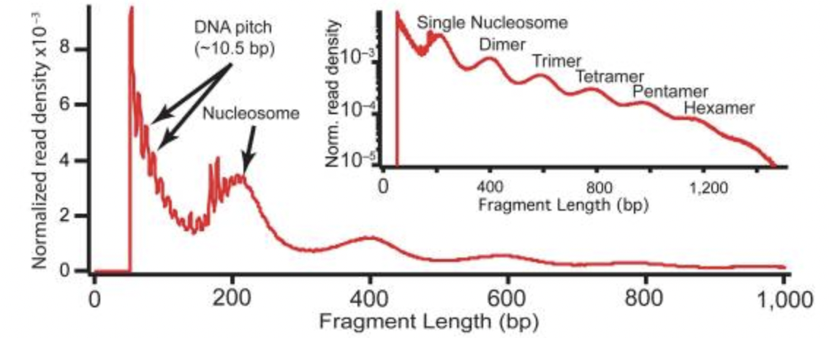
Filtering out low quality cells
3. Fragment size distribution
Nucleosomal periodicity in the distribution of fragment sizes.
Depletion of fragments that are the length of DNA wrapped around a nucleosome (approximately 147 bp).
plotFragmentSizes(..)
Notes:
https://genomebiology.biomedcentral.com/articles/10.1186/s13059-020-1929-3
https://www.ncbi.nlm.nih.gov/pmc/articles/PMC3959825/

Slide 39
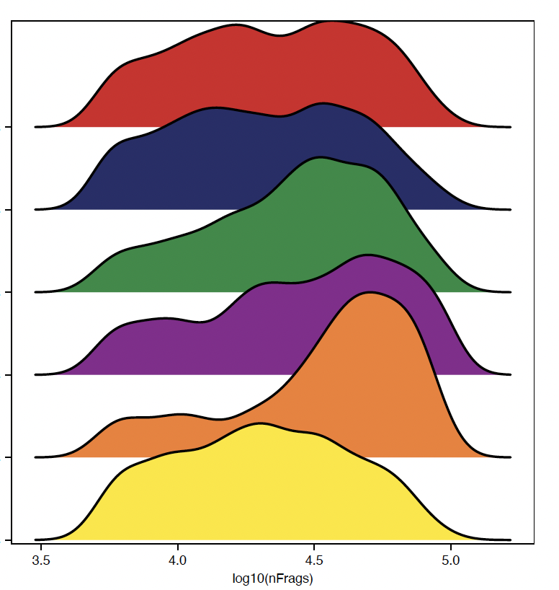
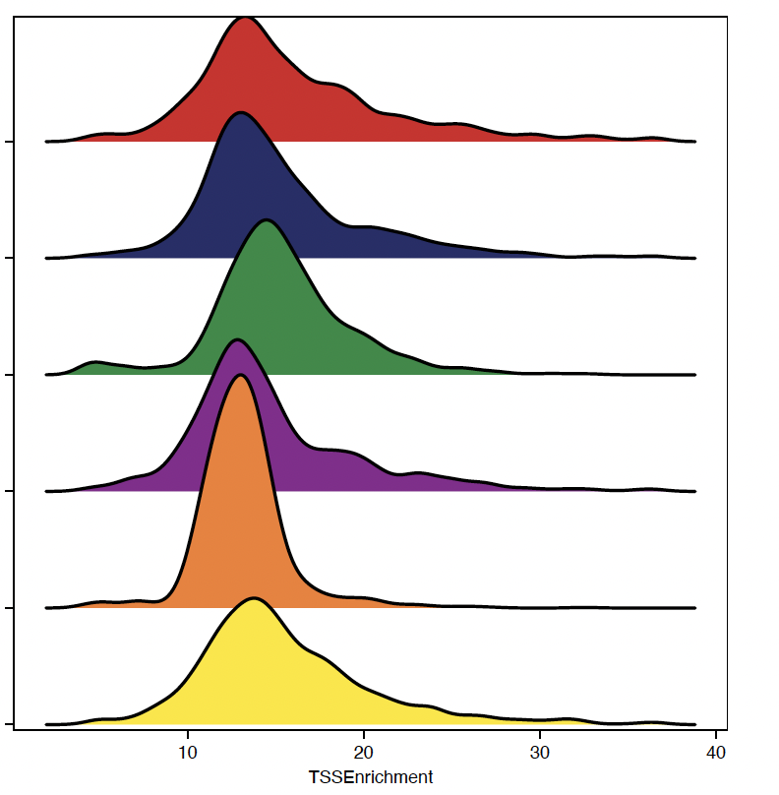
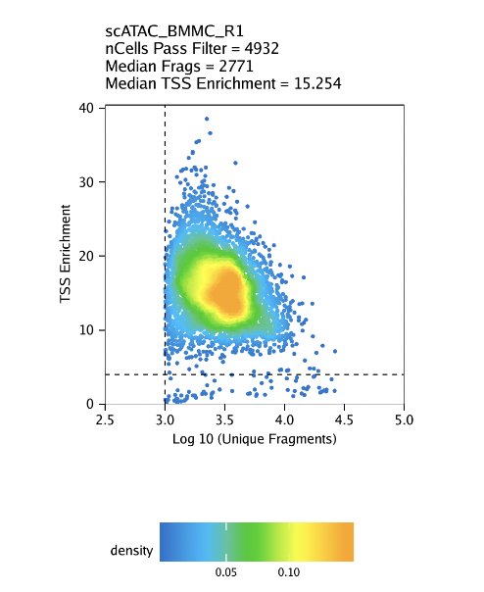
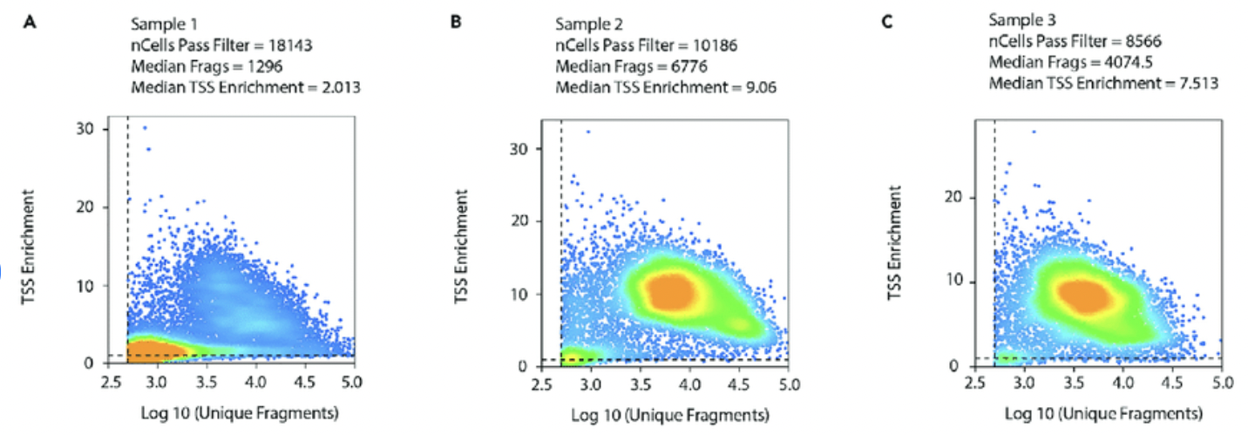
Visualize the quality of your data
TSS enrichment vs unique fragments
S1
S2
S3
S4
S5
S6
# unique fragments
TSS enrichment
DOI:10.1016/j.xpro.2022.101491

Slide 40
To summarize the pre-processing
Create a ArchR project using the fragments.tsv file
In ArchR command specify the thresholds for min fragment size and TSS enrichment
Specify to add the Tile Matrix (we will add other matrices to the same object)
Plots to verify the trend across samples

Slide 41
Break ~ 5 minutes

Slide 42
Workflow
From bench
Through the bioinformatic analysis
To the biological interpretation
Your cell’s regulome question
Fragments count
Embedding
Library preparation & sequencing
QC filtering low quality cells
Clustering
Demultiplex, read alignment and quantification
Layered dimensionality reduction
Find Markers - cell annotation
For more biological insight in cell’s regulome
Peak calling
Motif Enrichment
Motif Footprinting
Notes:
https://www.pnas.org/doi/10.1073/pnas.2206450119

Slide 43
5. Normalization and visualization on lower dimensional space
ArchR: addIterativeLSI(); addUMAP(); addTSNE()

Slide 44
For dimensionality reduction we need to identify features that can separate cells
Highly variable genes ??
Most accessible features ??
Notes:
majority of accesible regions are not transposed and this leads to many loci having 0 accessibile alleles
binarized scATAC-seq data matrix. This binarized matrix still ends up being mostly 0s because transposition is rare

Slide 45
Alternative normalization and dimensionality reduction
L = D - A
L: Graph Laplacian
D: Degree of each node
A: Node adjacency matrix
Consideration: cells look very similar.
Lots of 0s, bias in the PCs -> misleading similarity.
Spectral embedding (using eigenvectors from Graph Laplacian - created from cell-cell similarity matrix)
Introduced in 2021 SnapATAC, with recent 2024 updates SnapATAC2
Latent Semantic Indexing (LSI)
Introduced in 2015, implemented in different ways by Signac and 2021 by ArchR.

Slide 46
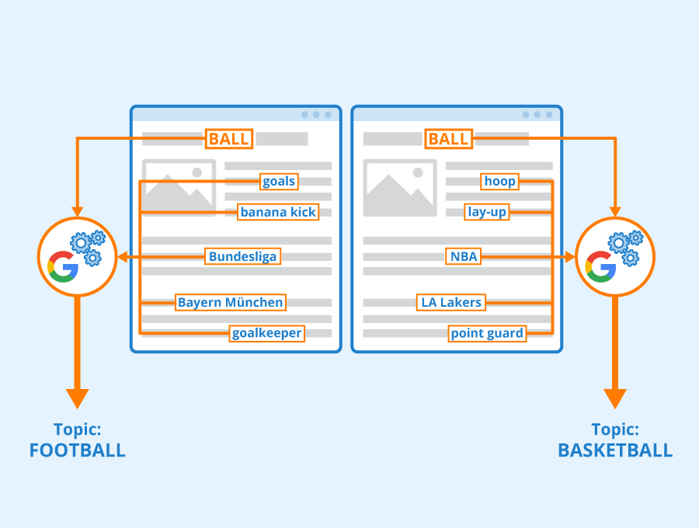
Latent semantic Indexing (LSI)
To find co-occurrences of words in documents to give insights into the topics of those documents
How many times a word appears in a document?
Term frequency of a word in a document
Are common words (this, what, and if ) informative? -> low ranking
Inverse document frequency of the word across a set of documents.
Use singular value decomposition (SVD) to identify patterns between words and documents.

Slide 47
LSI to normalize scATAC-seq data
Documents -> cells; Words -> regions/peaks
Help to identify features that are more “specific” rather than commonly accessible.
Normalize for term frequency followed by depth norm to a constant 10,000
Normalized by the inverse document frequency -> weighted features
The term frequency-inverse document frequency (TF-IDF) matrix reflects how important a region/peak is to a sample/cell
Low dimensional space -> singular value decomposition (SVD) of the most valuable information across cells/samples
Excel sheet illustrating LSI computations

Slide 48
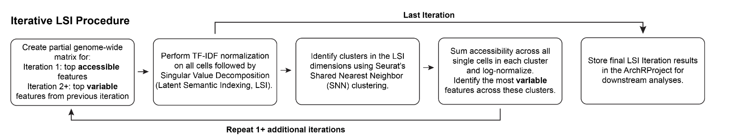
LSI to process scATAC-seq data
Identify low specific clusters of cells (set a low resolution) based on the most accessible 500bp tiles using TF-IDF normalization and the Seurat clustering approach
Derive the most variables features across clusters based on averaged accessibility within a cluster
Use the most variable feature as in scRNA-seq and iterate N times
Tune the N iterations if batch effects are present
addIterativeLSI()

Slide 49
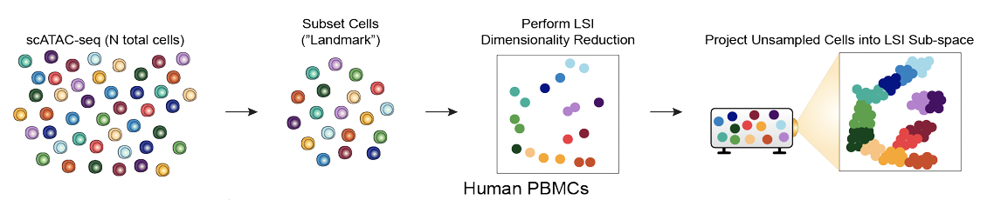
Estimated LSI approach for large dataset
Similar to Iterative LSI but
Use a subset of cells to define the sub-space
Normalize the remaining cells and project to the sub-space.
For very large datasets
Speeds up dimensionality reduction
Decrease the granularity of the data
Similar to landmark diffusion maps (LDM) implemented by SnapATAC but required for > 25k cells
ArchR required for >200k cells otherwise Iterative LSI is good

Slide 50
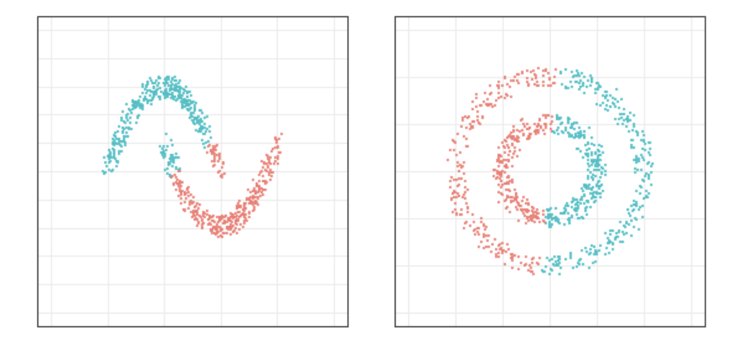
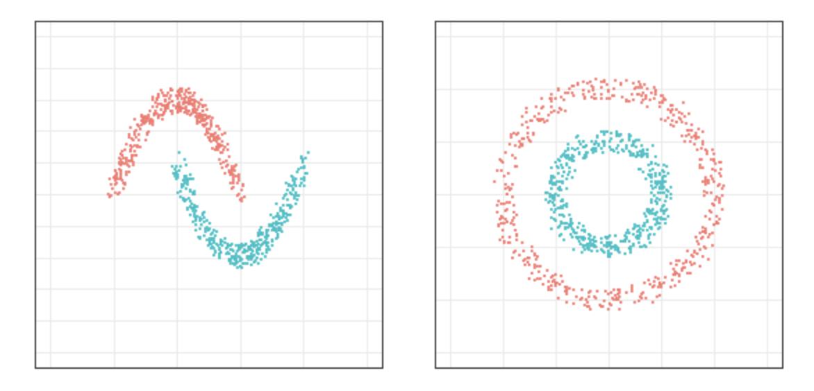
Spectral embedding
Cells are considered nodes in a graph
Edges between cells reflect cells that are immediately to each other
Spectral embedding is a partitioning technique of the resulting graph using the eigenvalue decomposition of the Graph Laplacian
The embedding has been used for clustering
K-Means clustering
Spectral clustering
Notes:
https://gjkoplik.github.io/spectral_clustering/#spectral_clustering

Slide 51
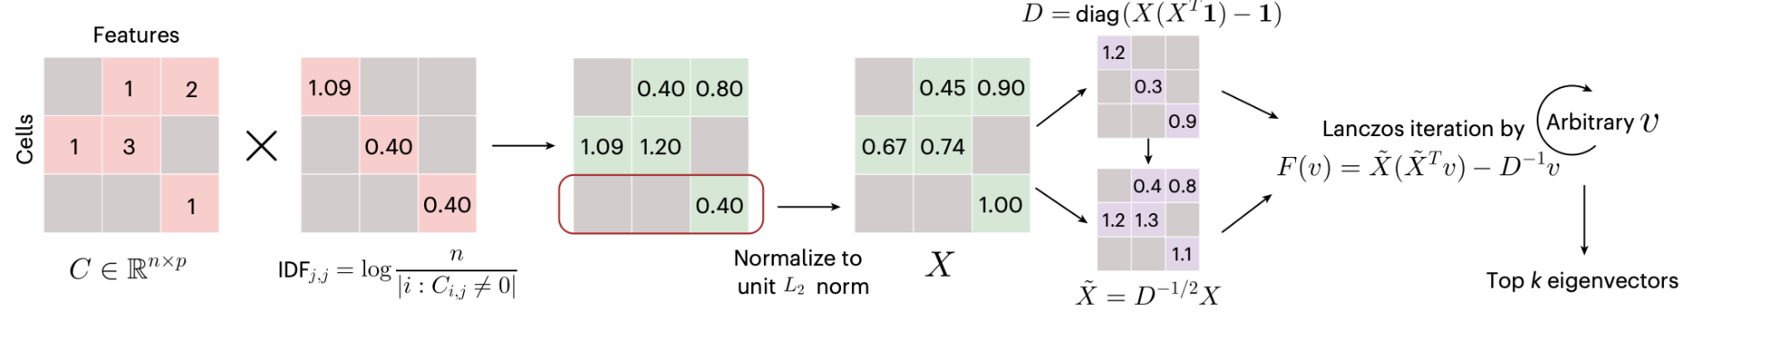
SnapATAC2 spectral embedding approach
feature scaling with inverse term frequency (Downweights features that are accessible in all cells)
row-wise L2 norm normalization
Identification of eigenvectors of Graph Laplacian created using normalized matrix X
Graph-based spectral embedding leverages eigenvalues and eigenvectors of the pairwise cell similarity matrix to perform dimensionality reduction - > time consuming
Matrix-free spectral embedding -> computes eigenvectors using the Lanczos algorithm wo constructing a full similarity matrix
A fast, scalable and versatile tool for analysis of single-cell omics data, Nature Methods 2024
Notes:
https://www.pnas.org/doi/10.1073/pnas.2206450119

Slide 52
Knowledge check 3
Which dimensionality reduction method is able to preserve the local structure of cells (neighborhood) in the low dimensional space?
PCA
UMAP
Both
Notes:
https://www.pnas.org/doi/10.1073/pnas.2206450119

Slide 53
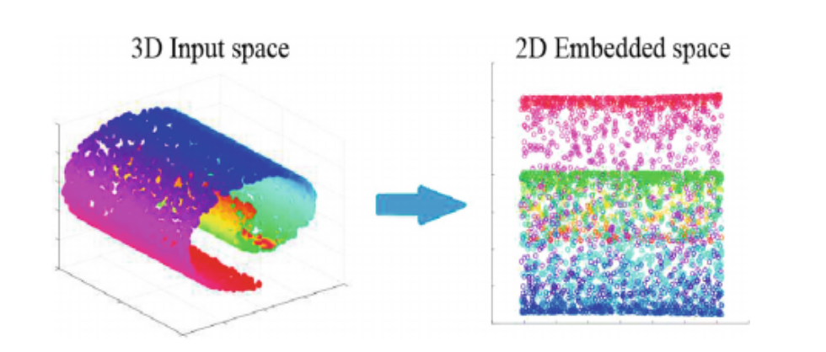
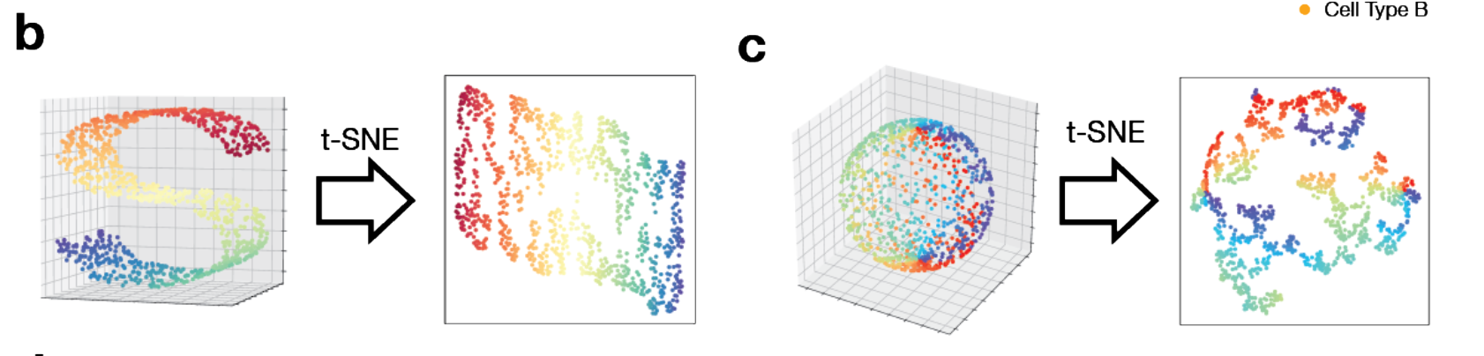
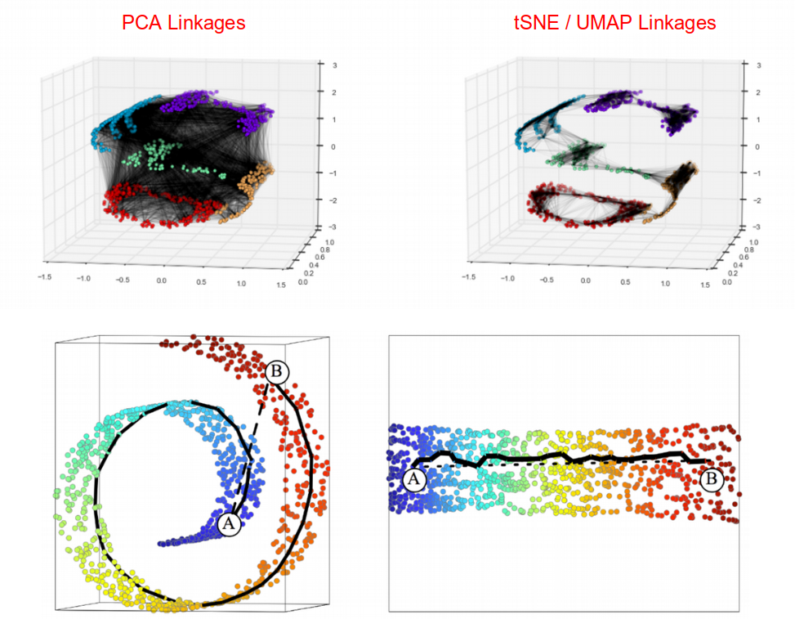
Embeddings methods for visualization: UMAP or t-SNE
Linear projection
Visualize in low dimensional space preserving the local vs global structure (i.e distance) as much as possible.
Linear (PCA, MDS) - Euclidean distance
Non linear combinations methods: t-SNE (t-Distributed Stochastic Neighbor Embedding) and UMAP (Uniform Manifold Approximation and Projection) - transforming Euclidean distances into “probability of being neighbor”
Non linear projection
Notes:
Source of image:
Salazar-Castro, Jose Alejandro, Paul D. Rosero-Montalvo, Diego Fernando Peña-Unigarro, Ana Cristina Umaquinga-Criollo, Zenaida Castillo-Marrero, Edgardo Javier Revelo-Fuelagán, Diego Hernán Peluffo-Ordóñez, and César Germán Castellanos-Domínguez. "A novel color-based data visualization approach using a circular interaction model and dimensionality reduction." In International Symposium on Neural Networks, pp. 557-567. Springer, Cham, 2018.
Cooley, Shamus M., Timothy Hamilton, Eric J. Deeds, and J. Christian J. Ray. "A novel metric reveals previously unrecognized distortion in dimensionality reduction of scRNA-Seq data." https://www.biorxiv.org/content/10.1101/689851v4

Slide 54
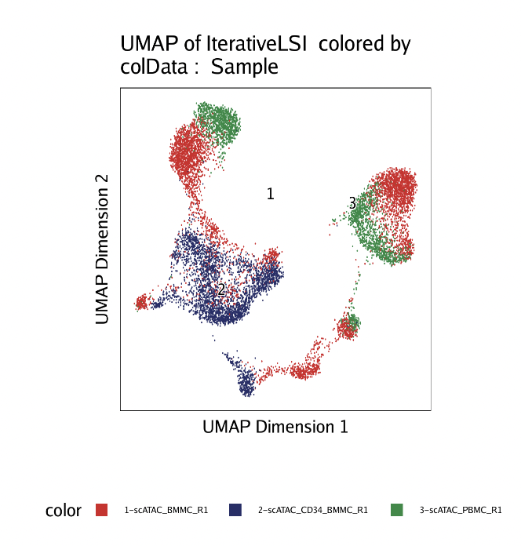
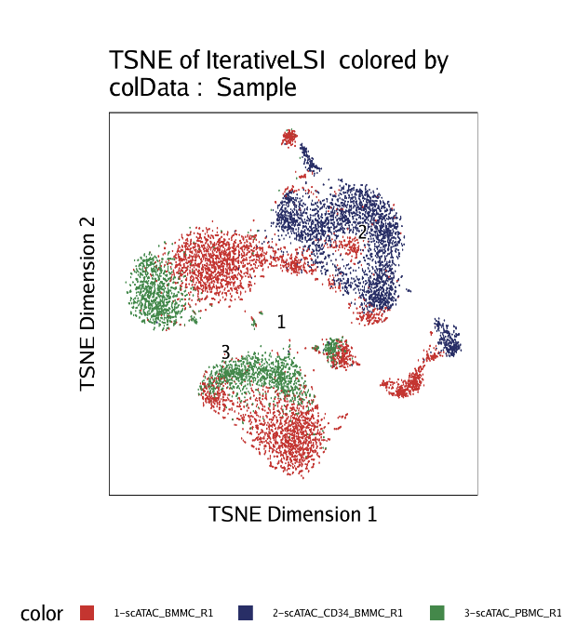

UMAP/tSNE visualization of IterativeLSI data
addUMAP()
addTSNE()
Notes:
https://www.pnas.org/doi/10.1073/pnas.2206450119

Slide 55

ArchR generates metrics plots
Reads in Promoter
Reads in Blacklist
NucleosomeRatio
-> (nDiFrags + nMultiFrags) / nMonoFrags
PromoterRatio

Slide 56



Doublets detection and removal
Granja, Corces et al., Nature Genetics 2021
Suggestion: check data after and before doublet removal
addDoubletScores() ; filterDoublets()

Slide 57
Workflow
From bench
Through the bioinformatic analysis
To the biological interpretation
Your cell’s regulome question
Fragments count
Embedding
Library preparation & sequencing
QC filtering low quality cells
Clustering
Demultiplex, read alignment and quantification
Layered dimensionality reduction
Find Markers - cell annotation
For more biological insight in cell’s regulome
Peak calling
Motif Enrichment
Motif Footprinting
Notes:
https://www.pnas.org/doi/10.1073/pnas.2206450119

Slide 58
6. Clustering and cell type annotation based on feature markers
ArchR: addClusters(); getMarkerFeatures()

Slide 59


ArchR use Seurat approach to find clusters
1. Build shared nearest neighbor graph
Build a k-nearest neighbor graph
Keep only edges between cells that share a neighbor
Adjust the edge weights between any two cells based on similarity
= Shared nearest neighbor graph
2. Community detection
Cluster of cells more connected than with cells of other communities
graph-based clustering detects clusters of arbitrary structures
optimizes modularity - resolution - 0.4-1.2 typically returns good results for 3K single-cell datasets
Notes:
Reference:
Xu, Chen, and Zhengchang Su. "Identification of cell types from single-cell transcriptomes using a novel clustering method." Bioinformatics 31, no. 12 (2015): 1974-1980.
Register for a workshop on Machine Learning Spring 2023

Slide 60

Clustering of IterativeLSI data using Seurat clusters
addClusters(..., reducedDims = "IterativeLSI", method = "Seurat", resolution = N) N[0.4-1.2]
Notes:
https://www.pnas.org/doi/10.1073/pnas.2206450119

Slide 61
How to identify marker genes having accessibility data
Gene expression is not known.
Are the regulatory elements of a gene accessible?
-> high gene expression, high activity.
Infer the gene expression using the distance between the tile and the gene -> GENE SCORE MATRIX
Validate on scRNAseq and scATACseq datasets

Slide 62

Best model to infer gene score matrix
Inferring gene score using 56 models.
Define gene window.
Overlap tiles.
Weigh distance and gene size.
Weights multiplied by #Tn5 insertions within each tile.
Summed across all tiles within the gene window -> gene score
Depth normalized across genes
Granja, Corces et al., Nature Genetics 2021
createArrowFiles(..,addGeneScoreMatrix = TRUE)
Notes:
https://pubmed.ncbi.nlm.nih.gov/33633365/

Slide 63



Relevant features identification
Getting the marker features based on the cell specific high activity.
Marker features based on pairwise comparison of two matched cell groups:
Select bias for matching
Normalization to equal variance
Nearest neighbor
Significant markers one group vs matched group
getMarkerFeatures(useMatrix = "GeneScoreMatrix",groupBy = "Clusters",
bias = c("TSSEnrichment", "log10(nFrags)"))

Slide 64
To summarize so far
Create a ArchR project using the fragments.tsv file
In ArchR command specify the thresholds for min fragment size and TSS enrichment
Specify to add the Tile Matrix, GeneScore matrix
Plots to verify the trend across samples
Add Doublets score and filter for doublets, then check!
Add IterativeLSI for normalization
AddUMAP, AddClusters using IterativeLSI (on LSI space)
Use GeneScoreMatrix to get the marker features

Slide 65
Break ~ 5 minutes

Slide 66
7. Advance analysis: Calling Peaks and Motif enrichment
ArchR: addGroupCoverages(); addReproduciblePeakSet(); peakAnnoEnrichment()

Slide 67
Where are the cell-type specific enhancers?
Peak-calling!
Nature Reviews Methods Primers, 2021
vol 2021
Trevino et al, Science 2020
Notes:
https://www.10xgenomics.com/blog/is-single-cell-epigenomics-right-for-me-atac-ing-your-research-questions-for-deeper-insights
https://www.10xgenomics.com/products/single-cell-multiome-atac-plus-gene-expression

Slide 68

Motivating Ideas
We cannot identify enhancer regions for each cell due to the sparsity of signal
Assumption: Cells of the same type share enhancers
Combining information across multiple cells within a cluster will allow us to identify enhancers
Distinguish signal from noise?
Enter Peak calling!

Slide 69
What is signal and what is noise?

Slide 70

Peak calling
Notes:
https://genomebiology.biomedcentral.com/articles/10.1186/s13059-020-1929-3

Slide 71

Peak calling: MACS2-shift-extend
Fragments from individual cells belonging to a given cluster
addReproduciblePeakSet(ArchRProj = demo_proj,
groupBy = "Clusters",
pathToMacs2 = findMacs2(),
method = "q")
Notes:
http://barc.wi.mit.edu/education/hot_topics/ChIPseq_ATACseq_2021/ChIPseq_ATACseq2021.pdf

Slide 72

Reproducibility assessed by calling peaks separately for each sample
Fragments from individual cells of sample1 belonging to a given cluster
Fragments from individual cells of sample2 belonging to a given cluster
addGroupCoverages(ArchRProj = demo_proj,
groupBy = "Clusters")
addReproduciblePeakSet(ArchRProj = demo_proj,
groupBy = "Clusters",
pathToMacs2 = findMacs2(),
method = "q")
Notes:
http://barc.wi.mit.edu/education/hot_topics/ChIPseq_ATACseq_2021/ChIPseq_ATACseq2021.pdf

Slide 73
(ArchR) steps to obtain a list of all peaks
For each cell-type/cluster
Keep list of non-overlapping 501 bp peaks that are
Reproducible across samples
Most significant in terms of enrichment over noise
Will allow us to identify peak regions either unique to or common across cell-types

Slide 74
Peak matrix contains accessibility of each peak for each cell
 | Cell_1 | Cell_2 | … | Cell_m
Peak_1 | 1 | 0 | … | 2
Peak_2 | 0 | 3 | … | 1
… |  |  | …
Peak_n | 0 | 0 | … | 4
Counts of insertions in each cell mapping to a given cell

Slide 75
Knowledge check 4
Are the counts of the number of insertions in each peak normalized across cells?
Yes
No
Notes:
https://www.pnas.org/doi/10.1073/pnas.2206450119

Slide 76
Knowledge check 5
What could be reasons why the same regions equally accessible in two cells have different numbers of sequenced insertions?
Differences in total number of mapped fragments
Differences in Signal-to-noise/TSS enrichment
Both
Notes:
https://www.pnas.org/doi/10.1073/pnas.2206450119

Slide 77
Use Wilcoxon test to identify differentially accessible peak regions
Cells belonging to cluster C1
Cells belonging to cluster C5
 | c1 | c2 | c3 | c4 | c5 | … | … | c93 | c94 | c95 | c96 | c97 | c98 | c99
p1 | 1 | 0 | 0 | 0 | 1 | … | … | 2 | 1 | 2 | 0 | 4 | 1 | 1
p2 | … | … | … | … |  | … | …
… |  |  |  |  |  | … | …
pn | … |  |  |  |  | … | … |  |  |  |  |  |  | …
Cells in clusters C1 and cluster C5 are specifically chosen so they have a similar distribution of log10(nFrags) and TSS
getMarkerFeatures(ArchRProj = demo_proj,
useMatrix = "PeakMatrix", groupBy = "Clusters",
bias = c("TSSEnrichment", "log10(nFrags)"),
testMethod = "wilcoxon")

Slide 78
Use Wilcoxon test to identify differentially accessible peak regions
Cells belonging to cluster C1
Cells belonging to cluster C5
 | c1 | c2 | c3 | c4 | c5 | … | … | c93 | c94 | c95 | c96 | c97 | c98 | c99
p1 | 1 | 0 | 0 | 0 | 1 | … | … | 2 | 1 | 2 | 0 | 4 | 1 | 1
p2 | … | … | … | … |  | … | …
… |  |  |  |  |  | … | …
pn | … |  |  |  |  | … | … |  |  |  |  |  |  | …
Peak p1 among cells in cluster C5 appear to be more accessible compared to cells in cluster C1
getMarkerFeatures(ArchRProj = demo_proj,
useMatrix = "PeakMatrix", groupBy = "Clusters",
bias = c("TSSEnrichment", "log10(nFrags)"),
testMethod = "wilcoxon")

Slide 79
Caution 1: Elevated false-positives with this test
The previous Wilcoxon test treated all cells as being independent of each other
Not true!
Cells are grouped based on the sample from which they are derived
Ignoring this cell-cell correlation results in elevated false positives
Solution: perform pseudo-bulk of the number of fragments across all cells from each sample
See details in scRNAseq workshop and this paper

Slide 80

Best practices : differential accessibility analysis in single-cell epigenomics
Many common DA tests give high false positives by treating cells as independent. Figure shows many spurious peaks.
The paper shows pseudobulk methods control false positives by aggregating cells per sample. They find very few false peaks.
Key takeaway: Use pseudobulk methods for more reliable scATAC-seq DA analysis to reduce incorrect findings.
Pseudo-bulk approaches
https://www.nature.com/articles/s41467-024-53089-5

Slide 81
Knowledge check 6
Assume sample-wise batch correction was used to obtain updated clusters and visualizations of the data. Will the fragments counts in the peaks also be corrected?
Yes
No
Notes:
https://www.pnas.org/doi/10.1073/pnas.2206450119

Slide 82
Caution 2: Avoid sample-wise batch correction
You will not be able to distinguish differences in peak accessibility due to the biology you are studying versus those driven by uninteresting technical/batch effects
See details in our scRNAseq workshop

Slide 83
Workflow
From bench
Through the bioinformatic analysis
To the biological interpretation
Your cell’s regulome question
Fragments count
Embedding
Library preparation & sequencing
QC filtering low quality cells
Clustering
Demultiplex, read alignment and quantification
Layered dimensionality reduction
Find Markers - cell annotation
For more biological insight in cell’s regulome
Peak calling
Motif Enrichment
Motif Footprinting
Notes:
https://www.pnas.org/doi/10.1073/pnas.2206450119

Slide 84

Motif signatures help us identify important transcription factors
Transcription factors/proteins bind to DNA sequences with particular sequence/motif patterns
These motif patterns are available in several databases
We use these patterns to identify peak regions carrying signatures of binding to particular transcription factors
addMotifAnnotations(ArchRProj = demo_proj,
motifSet = "cisbp", name = "Motif")

Slide 85


Slide 86

Identifying motif locations in peak regions by scoring with Position Weight Matrices (PWM)
Example: TATA-box motif PWM score calculation for given DNA sequence
Estimate the significance of the score assuming the prior expectations of frequencies of each of the 4 nucleotides (e.g., in all promoter regions of the organism)
Notes:
https://journals.pan.pl/Content/84175/PDF/6.pdf

Slide 87
Compute Motif presence absence matrix per peak
 | Motif_1 | Motif_2 | … | Motif_k
Peak_1 | TRUE | TRUE | … | FALSE
Peak_2 | FALSE | FALSE | … | TRUE
… |  |  | …
Peak_n | FALSE | FALSE | … | TRUE

Slide 88
Fisher’s test to identify motifs enriched in one set of peaks versus others
Universe of all peaks identified
Subset 1 : peaks identified as differentially present
Subset 2 : peaks identified to have a given motif
Is there a significant overlap between these two subsets?
Answer: Fisher’s exact or the hypergeometric test or ORA
peakAnnoEnrichment(ArchRProj = demo_proj,
seMarker = markersPeaks,
ArchRProj = demo_proj,
peakAnnotation = "Motif")

Slide 89
Tomorrow, at the end of the workshop (or today if not attending)
please take our survey:
https://www.surveymonkey.com/r/F75J6VZ
We use your suggestions to improve!

Slide 90
Introduction to scATAC-seq Data Analysis
April, 17-18 2025
Reuben Thomas
Michela Traglia
Ayushi Agrawal

Slide 91
Workshop organization
Session 1 (Thursday, 9am-12pm)
Cell regulome and ATAC-seq
Technology
From sequencer to fragments file
Pre-processing and QC
Break
Normalization, Dimensionality reduction, embedding
Clustering and cell type annotation based on feature markers
Break
Advance analysis: Calling Peaks and Motif enrichment
Session 2 (Friday, 9am-12pm)
Intro to ArchR
Demo
Integration scRNA-seq and scATAC-seq workshop - April 24 at 1pm - Register here
Notes:
https://www.pnas.org/doi/10.1073/pnas.2206450119

Slide 92



Tools - overview
R lang
R lang
R lang
R lang
R lang
R lang
Python
Python
Notes:
https://pmc.ncbi.nlm.nih.gov/articles/PMC11328424/pdf/13059_2024_Article_3356.pdf

Slide 93

8. ArchR - overview
Notes:
A comprehensive software suite for analysis of sc-ATAC-seq data that supports doublet removal, single-cell clustering and cell type identification, unified peak set generation, cellular trajectory identification, DNA element-to-gene linkage, transcription factor footprinting, mRNA expression level prediction from chromatin accessibility and multi-omic integration with single-cell RNA sequencing (scRNA-seq)
https://www.nature.com/articles/s41588-021-00790-6
https://www.pnas.org/doi/10.1073/pnas.2206450119

Slide 94

What is an Arrow file / ArchRProj?
• accessible reads and arrays are organized within
• Used as input for an ArchRProject
• ArchRProject stores the locations of these Arrow files and extracts their cell-centric metadata
• Arrow file - Stored on disk
• ArchRProj - Stored in memory

Slide 95

ArchR Arrow file creation
Notes:
These temporary Arrow files are then linked to a singular Arrow file. This linkage does not require reading and writing. Next, lowly-abundant barcodes are identified and fragments corresponding to the cells with more fragments than a user-defined minimum are read and written to a new Arrow file.

Slide 96

File infrastructure
Notes:
Rapid access and also data compression

Slide 97



Information access
Reading and writing into arrows is done in a parallel fashion

Slide 98

AnnData (used in SnapATAC2) is an alternative to ArrowFiles
Notes:
https://raw.githubusercontent.com/scverse/anndata/main/docs/_static/img/anndata_schema.svg

Slide 99

Which tool is the best?
SnapATAC - https://github.com/r3fang/SnapATAC
Signac - https://stuartlab.org/signac/index.html
SnapATAC2 - https://github.com/kaizhang/SnapATAC2
SnapATAC2 - Fastest, high accuracy; ideal if speed/accuracy are top priorities.
ArchR - Most memory-efficient; suitable for large datasets but has library size bias and struggles with identifying rare cell types and distinguishing similar subtypes.
ArchR requires a large amount of time to create the files needed to run an analysis
Signac requires substantially less time for the object creation step.
If speed and accuracy are paramount, SnapATAC2 is recommended. If memory efficiency is critical, ArchR might be a better choice, but consider its limitations in cell type identification and potential lower performance in gene activity prediction.
Notes:
https://pmc.ncbi.nlm.nih.gov/articles/PMC11328424/pdf/13059_2024_Article_3356.pdf

Slide 100
Demo
Input data
Cryopreserved human peripheral blood mononuclear cells (PBMCs) from a healthy female donor aged 25 were obtained by 10x Genomics.
Nuclei Isolation for Single Cell Multiome ATAC + Gene Expression Sequencing
Pbmc_unsorted_3k.fragments.tsv.gz
all PBMCs
3,009 cells identified by cellranger
pbmc_sorted_3k.fragments.tsv.gz
Granulocytes were removed by cell sorting
2,711 cells identified by cellranger

Slide 101
Helpful resources
Wynton Slack channel
ucsf-wynton.slack.com
Gladstone Bioinformatics Core slack channel
https://gladstoneinstitutes.slack.com/archives/C0145F1L7QS
Wynton tutorials
https://github.com/ucsf-wynton/tutorials/wiki
For questions:
ayushi.agrawal@gladstone.ucsf.edu
reuben.thomas@gladstone.ucsf.edu
michela.traglia@gladstone.ucsf.edu

Slide 102
Please take our survey to improve our workshops
https://www.surveymonkey.com/r/F75J6VZ
~3 min.
DATA SCIENCE TRAINING PROGRAM: upcoming workshops

Slide 103
Questions from participant
Are the insertion counts NOT normalized in peaks? If I remember correctly, the LSI is implemented for normalization.
Yes, insertion counts in peaks in ArchR are NOT normalized. See sample code in next slide.
When I analyzed the differential peaks for two groups (control vs mutant) using the default function of getMarkerFeatures() and then filtering by log2FC>0, the result was not the same as the pairwise comparison by defining useGroups and bgdGroups under the function. Theoretically, there should be overlapped peaks between these two methods, but I am confused as to why there were no overlaps.
Need more information. https://www.archrproject.com/bookdown/pairwise-testing-between-groups.html
After identifying differential motifs, is it possible to trace back the corresponding peak locations and target genes of the motifs in ArchR? I found that the outputs of diff motifs from ArchR only contain the genomic location of the motifs rather than the peaks. I'm asking this as I'm interested in identifying the specific motif in a different peak of the target gene/DEG in the mutant.
See sample code in next 3 slides.

Slide 104
Get info on peak count matrix
##get the peak matrix
peak_data <- getMatrixFromProject(ArchRProj = demo_proj, useMatrix = "PeakMatrix")
##view the peak count matrix
peak_data@assays@data$PeakMatrix[1:10, 1:3]
##get info on genomic ranges for peaks - this will also provide info on closest gene
rowRanges(peak_data)

Slide 105
Access/View the LSI reduction
View((demo_proj@reducedDims@listData[["IterativeLSI"]]$matSVD))

Slide 106
Motif presence in peaks
motif_presence <- getMatches(ArchRProj = demo_proj, name = "Motif", annoName = NULL)
motif_presence_matrix <- motif_presence@assays@data@listData[["matches"]] %>%
as.matrix() %>%
add(0)

Slide 108

Which tool is the best?
SnapATAC2
Creation of AnnData files based on 500 bp genome-wide tile matrix
QC filtering
Add 500bp Tile Matrix to AnnData and then run spectral embedding
UMAP and tSNE
Tile-based gene score
R
R
R
Python

Slide 109

Why use ArchR?
● Comprehensive
● Fast
● Doesn’t need to be run on HPC but provides easy export options if desired

Slide 110
Which tool is the best?
Benchmarking paper: Genome Biology 2024
Evaluated 8 data processing pipelines derived from 5 different scATAC-seq methods.
SnapATAC2 generally outperforms ArchR in terms of speed, accuracy in cell type identification, and gene activity score prediction.
Library Size Bias: LSI-based methods (Signac, ArchR) are biased by library size; SnapATAC methods mitigate this with linear regression-based normalization.
Gene Activity Scores: SnapATAC and SnapATAC2 outperformed ArchR and Signac for predicting gene activity scores.
Strengths & Weaknesses:
SnapATAC2: Fastest, high accuracy; ideal if speed/accuracy are top priorities.
ArchR: Most memory-efficient; suitable for large datasets but has library size bias and struggles with identifying rare cell types and distinguishing similar subtypes.
Method performance depends on dataset complexity:
Simple datasets: Feature aggregation, SnapATAC and SnapATAC2 performed best.
Complex datasets: SnapATAC and SnapATAC2 excel.
Recommendation: If speed and accuracy are paramount, SnapATAC2 is recommended. If memory efficiency is critical, ArchR might be a better choice, but consider its limitations in cell type identification and potential lower performance in gene activity prediction.

